Slide 1
Spring Boot - Eureka Server
Eureka Server is an application that holds the information about all client-service applications.
Every Micro service will register into the Eureka server and Eureka server knows all the client applications running on each port and IP address.
Eureka Server is also known as Discovery Server.
Micro Service Application 1
Register
Micro Service Application 3
Register
Eureka Server
Register
Micro Service Application 2

Slide 2
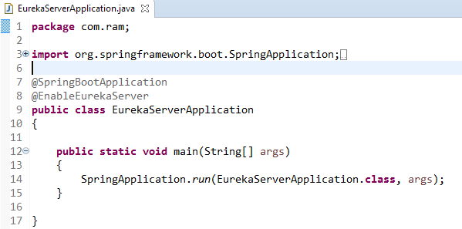


Spring Boot - Eureka Server
@EnableEurekaServer annotation. And the @EnableEurekaServer annotation is used to make your
Spring Boot application acts as a Eureka Server.
By default, the Eureka Server registers itself into the discovery.
pom.xml

Slide 3
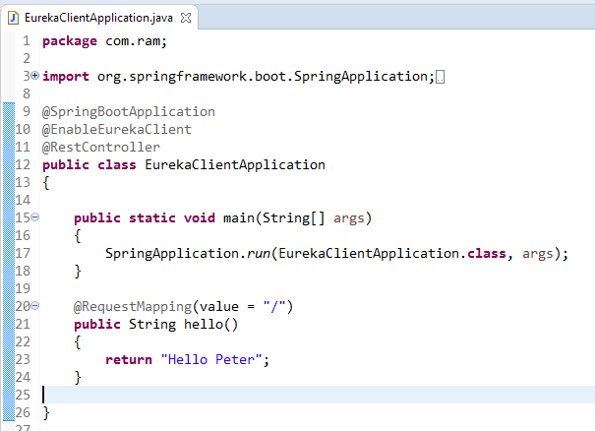
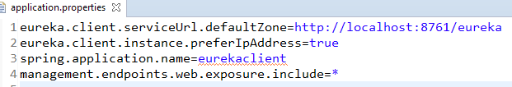
Spring Boot - Service Registration with Eureka
How to register the Spring Boot Micro service application into the Eureka Server.
Before registering the application, please make sure Eureka Server is running on the port 8761 or first build the Eureka Server and run it
@EnableEurekaClient makes the app into both a Eureka "instance" (i.e. it registers itself) and a "client"
To register the Spring Boot application into Eureka Server we need to add the below configuration in our application.properties file.

Slide 4
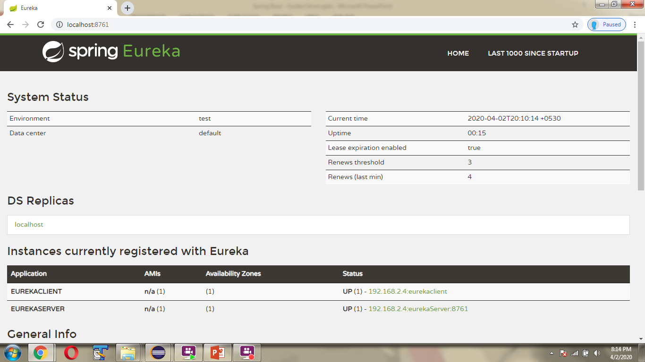
Spring Boot - Service Registration with Eureka

